Slide 1
Single cell RNA services
Shelly Pathak
May 2026

Slide 2
Novogene’s single cell transcriptomics services
Service type | Single nuclei RNA-seq | Single cell RNA-seq
Sample type | Fresh frozen tissues/organoids | Cryopreserved cell suspensions | Fresh tissues/organoids Blood Bone marrow
Sample inputs | > 50 mg/sample (Certain tissue/organoid types might require more) | 2-3 million cells/sample | Varies based on tissue type
Sample shipment | With dry ice in cryovials |  | Tissue preservation buffer With ice packs
Sample preparation | Nuclei isolation | Cell suspension thawing | Tissue dissociation
 |  | Dead cell removal (if needed)
Sample QC | Nuclei quantity Cell viability in nuclei suspension Nuclear morphology | Cell quantity Cell viability in cell suspension Cell morphology
Assay | 3‘ Gene expression | 3´ Gene expression 5´ Gene expression + V(D)J profiling
Sequencing | PE150 on NovaSeq X Plus
Data analysis | Cell Ranger only Standard analysis Also available: Custom analysis options
NEW
NEW
NEW
NEW

Slide 3
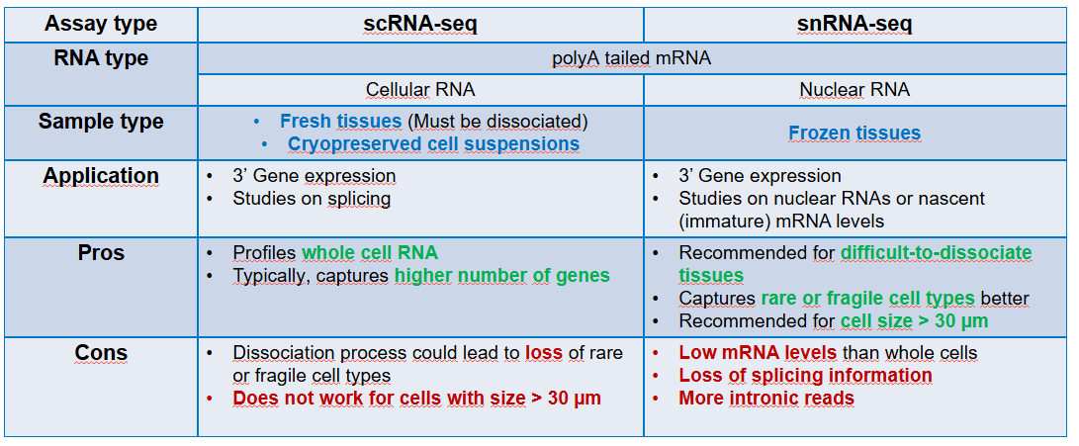
snRNA-seq vs. scRNA-seq – advantages and drawbacks

Slide 4
snRNA-seq vs. scRNA-seq
Tissue/Organoid
Frozen
Fresh
Send to Novogene
Send to Novogene
for fresh tissue dissociation*
Can be peformed by client and sent to Novogene as cryopreserved cell suspensions
Mechanical Digestion
Dissociation
Nuclei suspension
Cell suspension
snRNA-seq
scRNA-seq
*Reach out to PMM for evaluation of whether the specific tissue sample can be accepted for dissociation

Slide 5
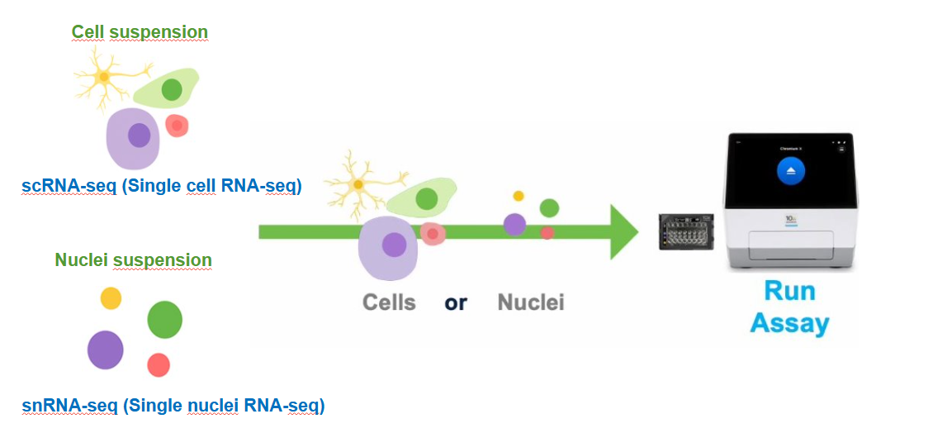
snRNA-seq vs. scRNA-seq
To clarify, the workflow uses the same kit, reagents and library preparation process. The only difference is the input material: for snRNA-seq, we load isolated nuclei instead of whole cells. Everything else in the protocol remains the same. i.e PE150 on Novaseq X plus, with data analysis options: Cell ranger, standard analysis and custom analysis

Slide 6
Questions we will ask
Sample Information
Species:(Human, mouse, other)
Number of samples / conditions:Total number of samples you plan to run.
Research application: Preference between snRNA or scRNA seq? (snRNA recommended option for frozen tissues).
Target cell recovery: Approx. number of cells you want per sample (e.g., 5,000 / 10,000 / 20,000).
Library types required:
Gene expression only (3’ GEX)
5’ GEX+V(D)J?
Number of reads/cell?
Bioinformatics: Bioinformatics needed?: Yes/No (If yes describe which kind of analysis is needed).

Slide 7
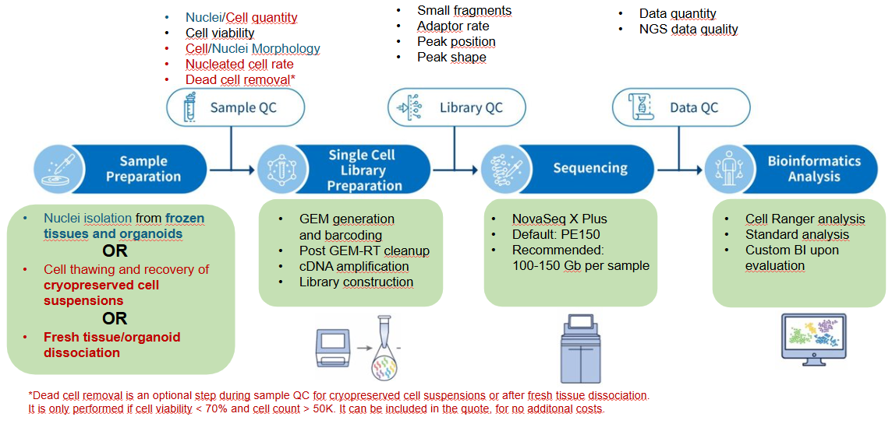
End to End Workflow

Slide 8
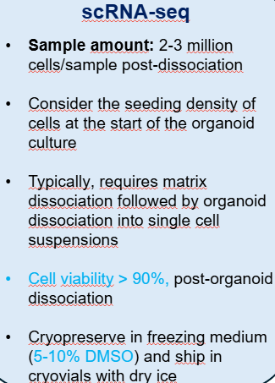
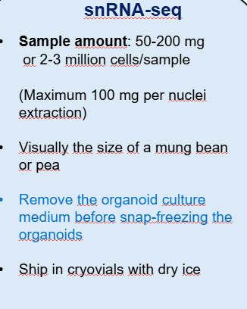
Our experience
Heart organoids
Choroid Plexus brain organoids
Stem cell derived renal duct
Human iPSc derived organoid pellets
Pancreatic islets of Langerhans organoids
Pancreas organoids
3D cell culture
Co-culture of tumour organoids with other cell types

Slide 10
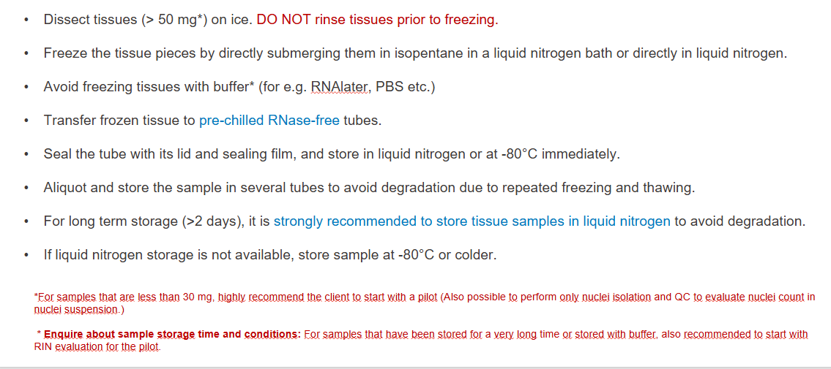
Sample prep for snRNA: Frozen tissues/organoids

Slide 11
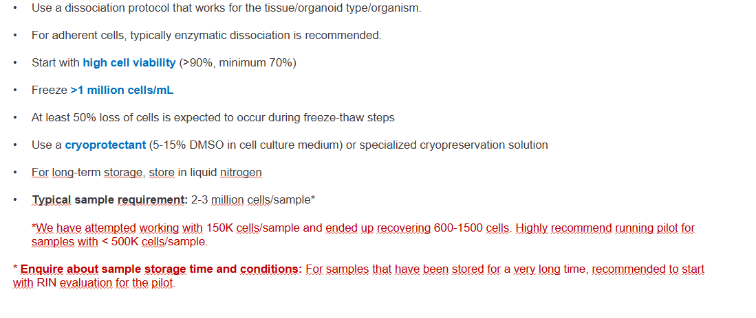
Sample prep for scRNA: cryopreserved cell suspensions

Slide 12
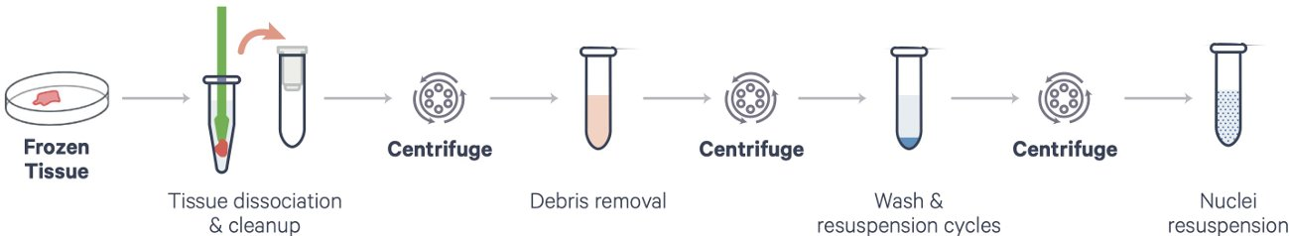
snRNA Seq Workflow
The client is to send snap-frozen tissues. Novogene prepares the nuclei suspension for snRNA seq
Novogene utilizes Chromium nuclei isolation kit from 10X Genomics for nuclei isolation
Recommended to load nuclei suspension on the GEM-X chip within 30 min of preparation
Not recommended to freeze isolated nuclei prior to running the assay
We cannot accept frozen/cryopreserved nuclei suspensions
List of tested tissues: https://www.10xgenomics.com/support/universal-three-prime-gene-expression/documentation/steps/sample-prep/chromium-nuclei-isolation-kit-tested-tissues

